Slide 1
Unit 1
Can you play the guitar?
Section A Grammar Focus-3c
七年级(下)

Slide 2

Objectives
To learn to use modal verb can to ask and answer questions about abilities
To learn new words: write, show, or, talk, talk to..., kung fu

Slide 3
Grammar Focus
can’t=cannot
Can you swim? | Yes, I can./No ,I can’t.
Can he play chess? | Yes, he can./ No ,he can’t.
Can you and Tom play chess? | Yes, we can./ No ,we can’t.
Can Jane and Jill swim? | Yes, they can ./No ,they can’t.
What can you do ? | I can dance./I can’t sing.
What club do you want to join? | We want to join the chess club.

Slide 4
用 Can …? 句型询问能力
一、阅读 Grammar Focus 部分, 完成下列句子。
Can you swim?
— 你会游泳吗？ _______________
— 不，我不会。 _______________
2. — 你们会说英语吗？ ______________________
— 是的，会。 ______________________
No, I can’t.
Can you speak English?
Yes, we can.

Slide 5
Can she play chess?
— 她会下棋吗？ _________________
— 不会。 _________________
— 贝尔和简会跳舞吗？ _______________________
— 是的，他们会。 _____________
— 你会做什么？_______________
— 我会弹吉它。 ______________________
No, she can’t.
Can Bill and Jane dance?
Yes, they can.
What can you do?
I can play the guitar.

Slide 6
二、探究乐园。
1. 可以看出，在 Can…? 句型中，情态 动词 can 没有_____ 和 ___ 的变化。
2. 用情态动词 can 来询问他人的能力可 以归纳为以下句型：
人称
数

Slide 7
主语 动词原形
Can + _____ + __________ + 其他?
肯定回答: _________________
否定回答: _________________
What + can + _____ + ____?
Yes, 主语 + can.
No, 主语 + can’t.
主语 do

Slide 8

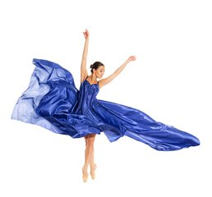
情态动词can的用法：
can + V. 会做 / 能做......
-Can you...?
sing
/ I /
-Yes, I can.
-No, I can’t.
sing
dance
/æ/
dance

Slide 9


draw / paint
swim
/ I /
swim

Slide 10


play chess
/e/
play chess
play the guitar
/gI't a: /
play the guitar

Slide 11

speak English
/i:/
speak English
tell stories in English
用英语讲故事

Slide 12

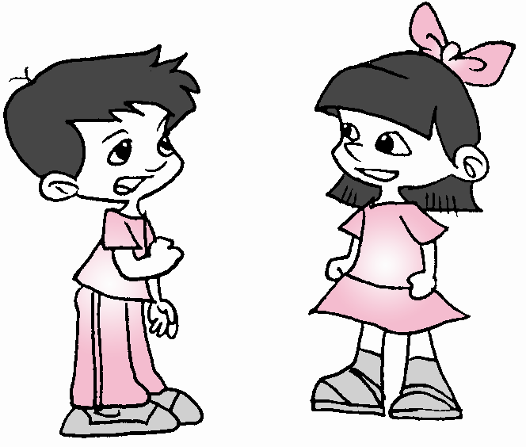

Can Wu Jun speak
English?
No, he can’t. But he can speak Chinese.
英语
English
汉语
Chinese
Wu Jun

Slide 13

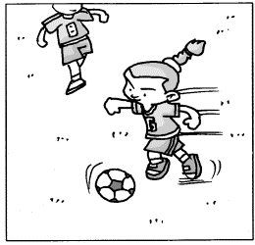
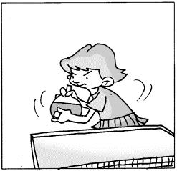
No, he / she can’t. But he / she can …
Can …?
Jenny

Slide 14

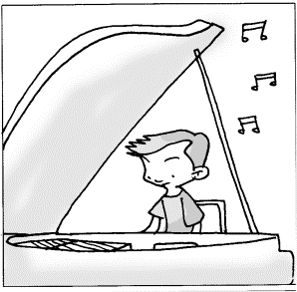
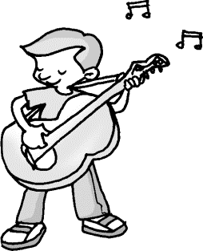
No, he / she can’t. But he / she can …
Can …?
Tom

Slide 15

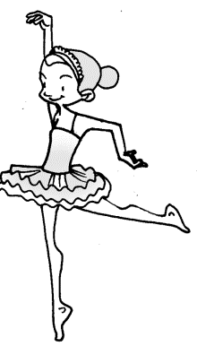
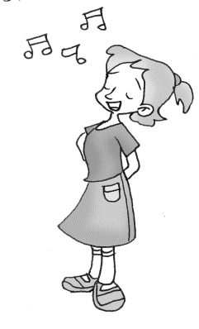
No, she can’t. But she can …
Can …?
Linda

Slide 16
3a
Write questions and answers with the words and phrases.
1. Wu Jun/speak English/speak Chinese
______________________________
_________________________________
2. Mike/play basketball/play tennis
_________________________
_______________________________
Can Wu Jun speak English?
No, he can’t, but he can speak Chinese.
Can Mike play basketball?
No, he can’t, but he can play tennis.

Slide 17
3. Jane and Jill/dance/sing
_______________________
____________________________
4. Grace/play soccer/play volleyball
_____________________
_________________________________
5. Bill/write stories/tell stories
____________________
______________________________
Can Jane and Jill dance?
No, they can’t, but they can sing.
Can Grace play soccer?
No, she can’t, but she can play volleyball.
Can Bill write stories?
No, he can’t, but he can tell stories.

Slide 18

What can you do?
Take turns to say what you can do.
School Show
Sunday 6:00 p.m.
in the music room.
What can you do?
Come and show us!

Slide 19
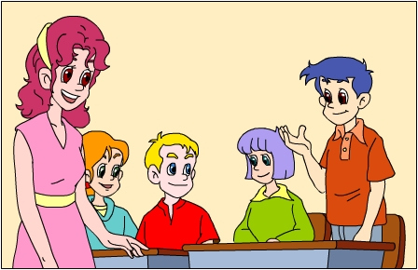
I can play the guitar.

Slide 20



I can do kung fu.
I can tell English stories.
I can sing and dance.

Slide 21

Make a list of what you can do in your group.
Li Meng
S2
S3
S4
S5
S6
play the guitar
do kong fu
…

Slide 22

In my group, Li Meng can play the guitar. S2 can do kong fu. ________________________________________________________________
S3 can sing and dance. S4 can tell English stories. S5 can …

Slide 23
3b
Complete the poster with the
words in the box.
Students Wanted for School Show
We want students for the school show.
Can you _____ or ______?Can you ____the guitar? Can you ______ stories?
Please talk to Mr. Zhang after school.
play
sing
tell
dance
sing
dance
play
tell

Slide 24
Writing:
假设你擅长音乐或讲故事，你很想参加学校公演，现在给你的英语老师写一份信说明你的特长和愿望。
Dear Ms. Jiang,
I am Jane from Class ... __________________
___________________________________________
___________________________________________
___________________________________________
_________ Yours sincerely,
Jane

Slide 25
One Possible Version
Dear Ms. Jiang,
I am Jane from Class 9. It is nice to read the poster for school show. I want to take part in it very much. I am good at music. I can sing and dance. Besides, I can play the guitar well. By the way, I can be good with (与......和得来) other students.
Please write to me soon!
Yours sincerely,
Jane

Slide 26
3c
What can your group do in the school show? Make a list.
Name What can you do?
School Show
Li Xin do kung fu
Sunday 6:00 p.m.
in the music room.
What can you do?
Come and show us!
I can do kung fu.
What can you do, Li Xin?

Slide 27
Language points
1. speak、tell、say、talk 的区别用法。
1) speak 说（某种语言）；说话
speak English 说英语 speak French 说法语
Mr. Smith can speak Chinese well.
史密斯先生说汉语说得很好。
2) tell 讲述；告诉
Can your grandma tell stories?
你奶奶会讲故事吗？

Slide 28
tell sb. 告诉某人;
tell sb. to do sth. 告诉某人做某事
Let’s go and tell our teacher. 我们去告诉老师吧。
Tell Eric to bring his basketball to school.
告诉埃里克把他的篮球带到学校来。

Slide 29
3) say 说(强调所说的内容, 常跟一个句子)
Mr. Lin says “I’m your new teacher. ”
林老师说，“我是你们的新老师。”
“I don’t know.” Linda says.
琳达说：“我不知道。”

Slide 30
2. show 名词 演出；节目
动词 给……看；展示
school show 校园演出
talent show 才艺表演
We want students for the school show.
我们需要学生参加我们的校园演出。

Slide 31
4) talk 说话；交谈（强调与他人进行语言交流）
talk to sb. 与某人说话
talk with sb. 与某人交谈
You can talk to Mr. Black.
你可以和布莱克先生谈一下。
Mary is talking with Jenny.
玛丽正在和詹妮谈一下。

Slide 32
show sb. (sth.) 给某人看(某物)
Come and show us.
来给我们（表演）看一下。
Can you show me your new iPad?
你能让我看一下你的新的平板电脑吗？

Slide 33
3. and 和 or 的用法辨析。
1) and 和、且(用于肯定句中)
Tom and Jack can play soccer well.
汤姆和杰克能打足球打得很好。
2) or 或者; 也不(用于疑问句中或否定句中)
Can you sing or dance?
你会唱歌还是跳舞？
My sister can’t play basketball or soccer.我姐姐不会打篮球也不会踢足球。

Slide 34
4. want (想要)的用法：
1) 想干什么 want to …
I want to play ping-pong.
They want to join the sports club.
2) 主语是第三人称单数时, 用want 要作
变化。
He wants to play basketball.
She wants to join the chess club.
Li Xiaweng wants to play the piano.

Slide 35
3) 变疑问句、否定句要借助助动词do
或does。
- Do you want to play soccer?
- Yes, I do. / No, I don’t.
- Does he want to go home by bus ?
- Yes, he does. / No, he doesn’t.

Slide 36
4) wanted 是want的过去式和过去分词
“sb. wanted” 结构常用于招聘或启事等的标题。
如：Teacher Wanted 招聘教师
Cook Wanted 招聘厨师
Help Wanted 寻求帮助
Students Wanted for School Show
学校公演招募学生

Slide 37
5. talk的用法：
1. talk to sb. 对某人谈话
2. talk with sb. 与某人交谈
3. talk about sb./sth. 谈论某人／某事
4. talk to sb. about sth 对某人谈论……
5. talk with sb. about sth 与某人谈论……

Slide 38

一、选词填空。
speak, tell, say, talk, show
talk
1. Ms. Wu wants to ____ to his son.
2. Jenny and Mary can _____ English well.
3. Can you _____ your new photo, Grace?
4. Bob ____ “I can play chess well.”
5. Mr. Li often ____ us interesting stories.
speak
show
says
tells

Slide 39
二、按要求完成句子，每空一词。
Li Juan can speak English.
(改为一般疑问句)
_____ Li Juan _______ English?
2. They can play volleyball well.
(改为否定句)
They _____ _____ volleyball well.
Tom can do Chinese kung fu.
(对划线部分提问)
______ can Tom ____?
Can speak
can’t play
What do

Slide 40
4. Jenny wants to join the music club.
(对划线部分提问)
______ _____ does Jenny want to join?
5. Bill does well in sports. (改为同义句)
Bill ____ _____ _____ sports.
What club
is good at

Slide 41
三、根据提示词，仿照例句编写对话。
Tony/sing/dance
例： — Can Tony sing?
— No, he can’t, but he can dance.
1. you / play tennis / play basketball
—
—
2. Lingling / speak English / speak Chinese
—
—
Can you play tennis?
No, I can’t, but I can play basketball.
Can Lingling speak English?
No, she can’t, but she can speak Chinese.

Slide 42
四、翻译下列句子。
他们将如何和对方对话？
把这篇文章剪下来拿给你的老板看。
3. 你会唱歌或者跳舞吗？
How will they talk to each other?
Cut out this article and show it to your boss.
Can you sing or dance?

Slide 43
Homework
Write something about what you
can do and what club you want to
join.

Slide 44
Thank You!

